Slide 1

POUR one out for A11y
The 4 Principles of WCAG
August 2022

Slide 2

Who am I?
Who am I and why am I here?

Slide 3
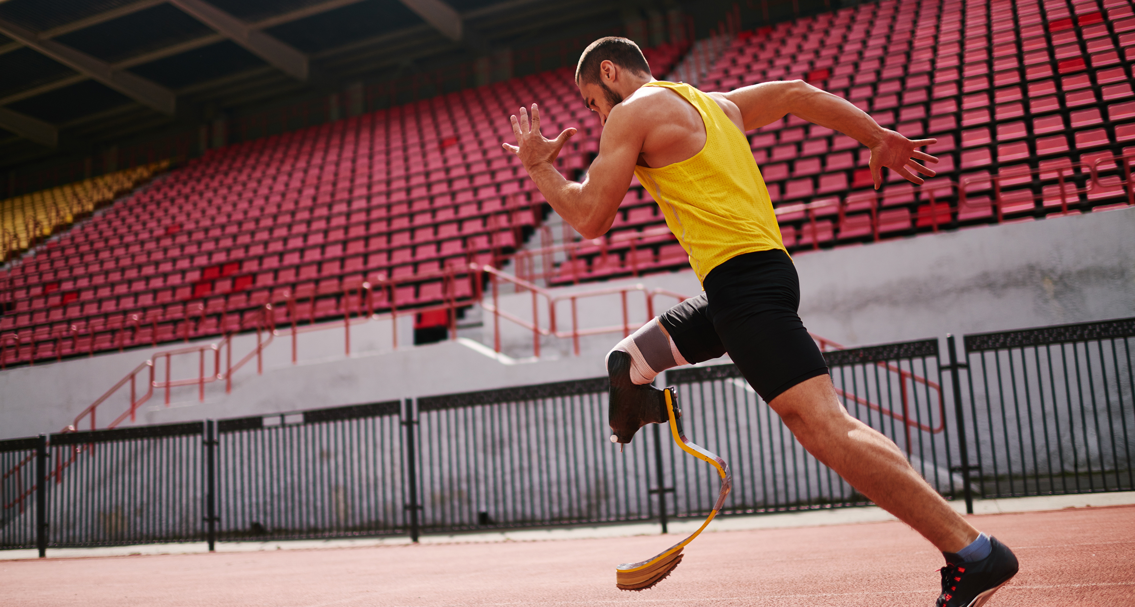
What is A11Y?
A numeronym for the word Accessibility.
Accessibility – “…word used to describe whether a product can be used by people of all abilities.” – Microsoft Accessibility Fundamentals
Disability – “…a mismatch in interaction between the features of a person’s body and the features of the environment in which they live.” – Microsoft Accessibility Fundamentals
Assistive Technology – “…any item, piece of equipment, software program, or product that is used to increase, maintain, or improve the functional capabilities of people with disabilities.” – Assistive Technology Industry Association

Slide 4

What is WCAG?
Web Content Accessibility Guidelines
Published by the Web Accessibility Initiative (WAI) of the World Wide Web Consortium (W3C) in 1999.
WAI is also responsible for the WAI-ARIA (Accessible Rich Internet Applications) technical specification.
WCAG is the foundation of most Accessibility regulations.
Other W3C Accessibility Guidelines include: UAAG and ATAG.
Notes:
“WAI-ARIA is a technical specification written by the World Wide Web Consortium (W3C). The specification is most commonly used by developers to build interactive website content that is accessible to people with disabilities.”” – Siteimprove

Slide 5
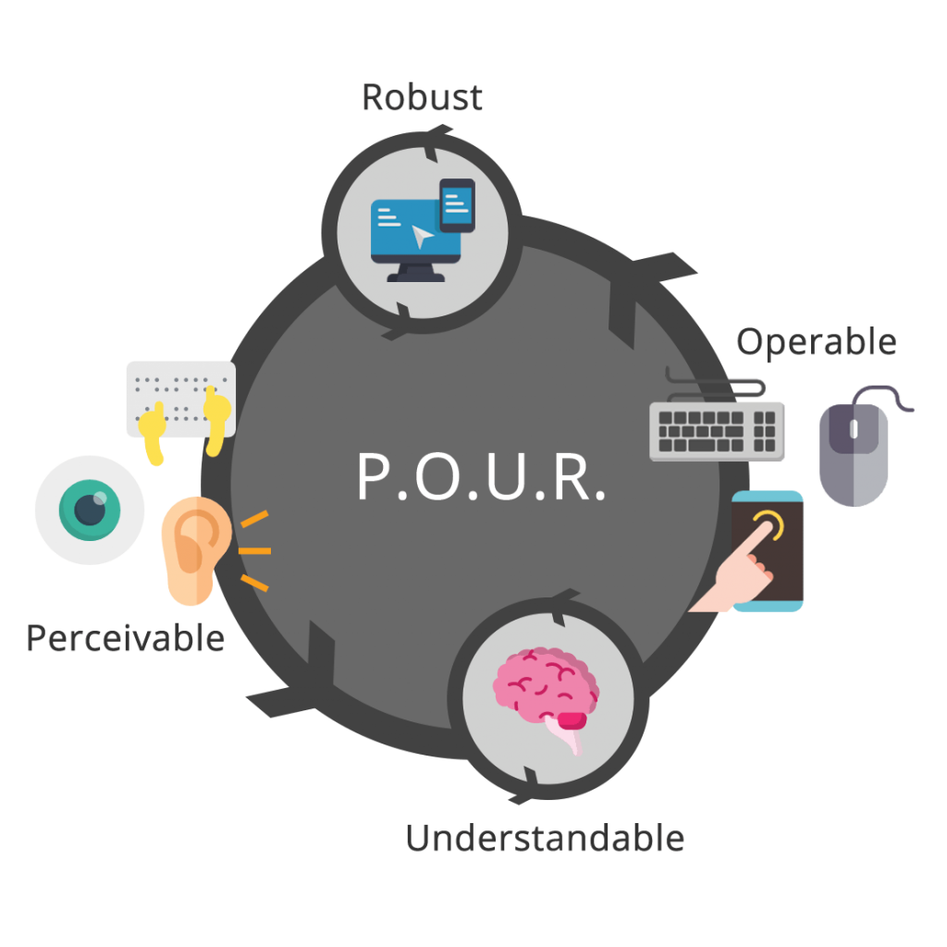
What is POUR?
The 4 core principles of WCAG.
Stands for:
Perceivable
Operable
Understandable
Robust
Used like categories for the guidelines to help define each respective group of guidelines seeks to accomplish in terms of accessibility.
There are 13 guidelines, as of WCAG 2.1.
Each guideline is then further defined using a set of success criterion, which help determine level of conformance (A, AA, or AAA).
Notes:
The draft of WCAG 3.0 can be viewed at https://www.w3.org/TR/wcag-3.0.

Slide 6

Perceivable
Information and user interface components must be presentable to users in ways they can perceive.
Guideline 1.1: Text Alternatives: Provide text alternatives for any non-text content so that it can be changed into other forms people need, such as large print, braille, speech, symbols, or simpler language.
Guideline 1.2: Time-based media: Provide alternatives for time-based media.
Guideline 1.3: Adaptable: Create content that can be presented in different ways (for example simpler layout) without losing information or structure.
Guideline 1.4: Distinguishable: Make it easier for users to see and hear content including separating foreground from background.

Slide 7

Operable
User interface components and navigation must be operable.
Guideline 2.1: Keyboard Accessible: Make all functionality available from a keyboard.
Guideline 2.2: Enough Time: Provide users enough time to read and use content.
Guideline 2.3: Seizure and Physical Reactions: Do not design content in a way that is known to cause seizures.
Guideline 2.4: Navigable: Provide ways to help users navigate, find content, and determine where they are.
Guideline 2.5: Input Modalities: Make it easier for users to operate functionality through various inputs beyond keyboard.

Slide 8

Understandable
Information and the operation of user interface must be understandable.
Guideline 3.1: Readable: Make text content readable and understandable.
Guideline 3.2: Predictable: Make web pages appear and operate in predictable ways.
Guideline 3.3: Input Assistance: Help users avoid and correct mistakes.

Slide 9

Robust
Content must be robust enough that it can be interpreted reliably by a wide variety of user agents, including assistive technologies.
Guideline 4.1: Maximize compatibility with current and future user agents, including assistive technologies.

Slide 10

Why? How?
Why should I care about A11y?
Why should I learn about A11y?
How can I improve A11y?
Why not just automate it?
Learning about A11y helps us all make more informed decisions that can benefit everyone.
A concept sometimes referred to as the Curb Cut Effect.
True A11y means also being inclusive.
Be an ally.
Take an A11y first approach.
You cannot 100% automate A11y conformance.
I have an example and put this line here to remind me to show it!

Slide 11
DEMO TIME!

Slide 12

QA
Anything else you would like to know?
Anything that did not quite make sense?

Slide 13

THANK YOU!
Erissa Renée Duvall
Home Page:
https://corgidev.com
Twitter & Twitch:
@TheCorgiDev
LinkedIn, Instagram, & GitHub:
@CorgiDev
Mastodon:
https://a11y.info/@CorgiDev

